Slide 1
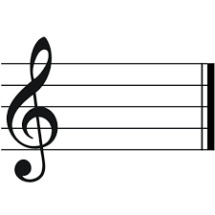

Harmony Search
Optimization of penalty kick Agent
By
Kevin Vora & Maitry Trivedi

Slide 2
Intuition
Inspired by the improvisation of Jazz musicians
Pitch adjustment and manipulating the notes
Dilemma of choosing the note to play next
Aesthetic harmony which excites the Audience

Slide 3
Basic Structure
Musician → Decision Variable
Appreciation from audience → Fitness
Practice → Iteration
Harmony Memory → Decision Vectors
Harmony Memory Consideration Rate → Exploration operator
Pitch Adjustment Rate → Exploitation operator
Harmony → Solution Vector

Slide 4
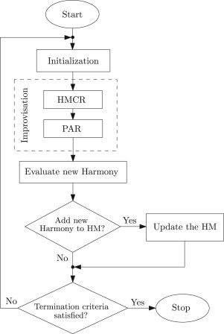
Algorithm
if (rand[0,1]<HMCR): selected from HM
Else: L+(U-L)*rand[0,1]
X_{new}=X_{old}+BW. rand(L,U)
Notes:
HMCR decides how much of the previous solution will stay the same in the new one?
pitch adjustment has to do with the possibility the algorithm to change the value in each decision variable looking for better solution.

Slide 5
Applications
Construction Systems
Optimization of Water Distribution Network

Slide 6
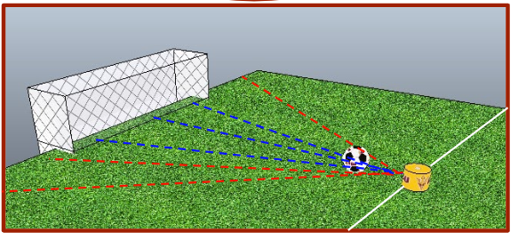
Implementation

Slide 7
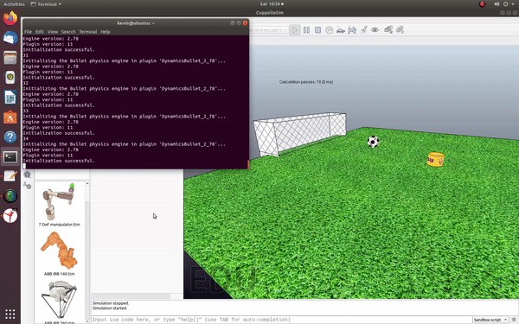

Slide 8
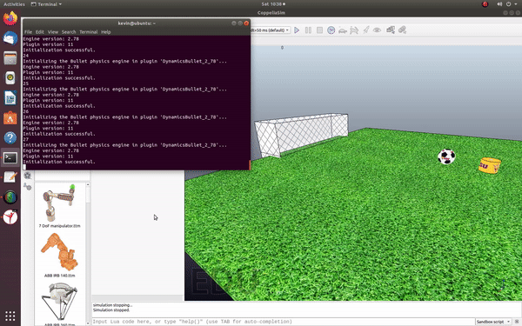

Slide 9
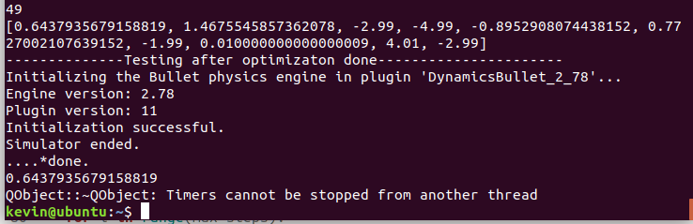

Slide 10
Conclusion & Future scope
Simple, exploration, exploitation, etc
Multiagent systems
Complex reward function optimization

Slide 11
Thank You

